Slide 1
Configure a Switch
LAN Switching and Wireless – Chapter 2

Slide 2
Objectives
Summarize the operation of Ethernet as defined for 100/1000 Mbps LANs in the IEEE 802.3 standard.
Explain the functions that enable a switch to forward Ethernet frames in a LAN.
Configure a switch for operation in a network designed to support voice, video, and data transmissions.
Configure basic security on a switch that will operate in a network designed to support voice, video, and data transmissions.

Slide 3
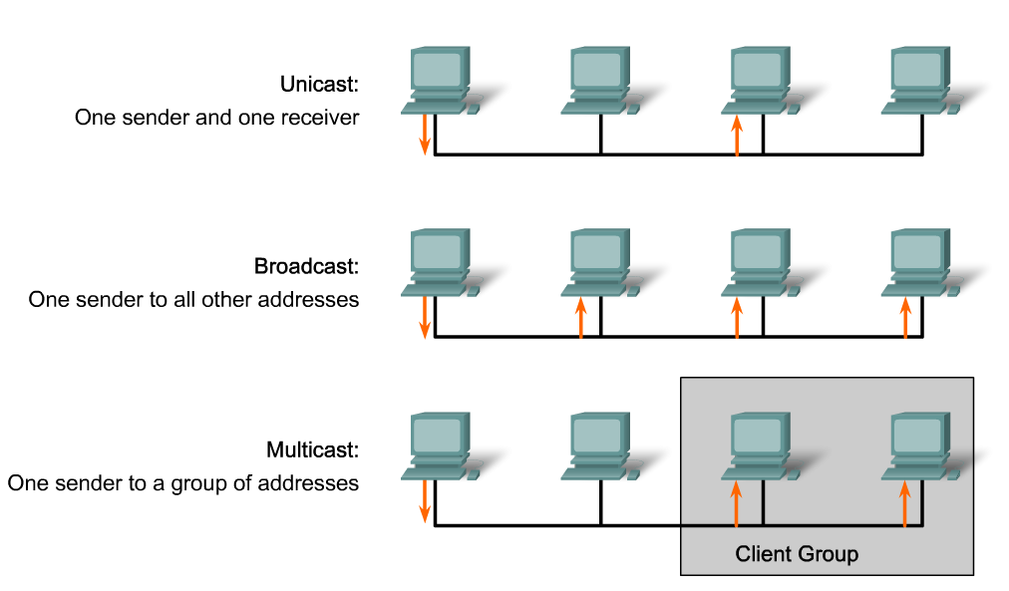
Summarize the operation of Ethernet as defined for 100/1000 Mbps LANs in the IEEE 802.3 standard
Describe the key elements of Ethernet/802.3 networks

Slide 4
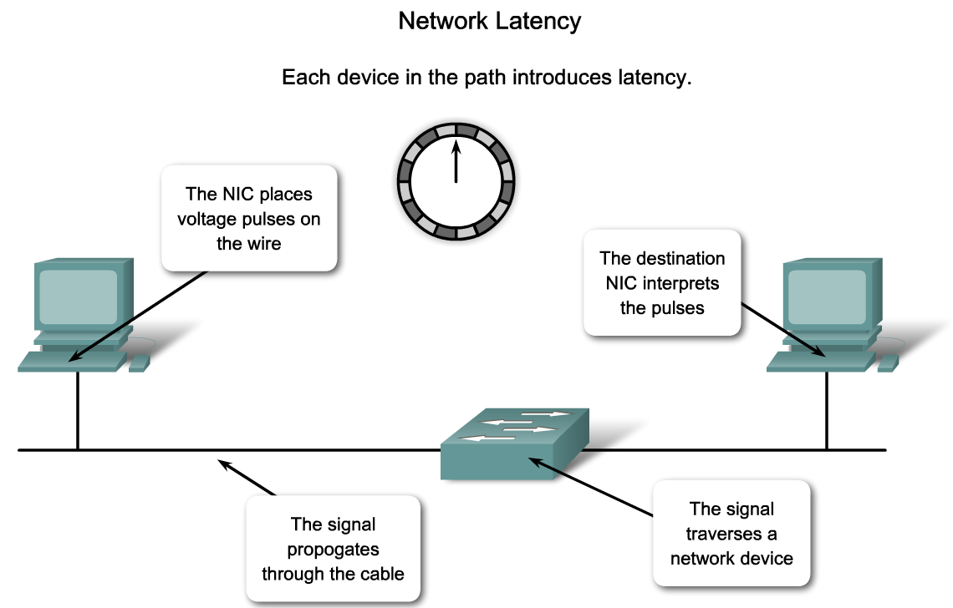
Summarize the operation of Ethernet as defined for 100/1000 Mbps LANs in the IEEE 802.3 standard
Describe the design considerations for Ethernet/802.3 networks

Slide 5
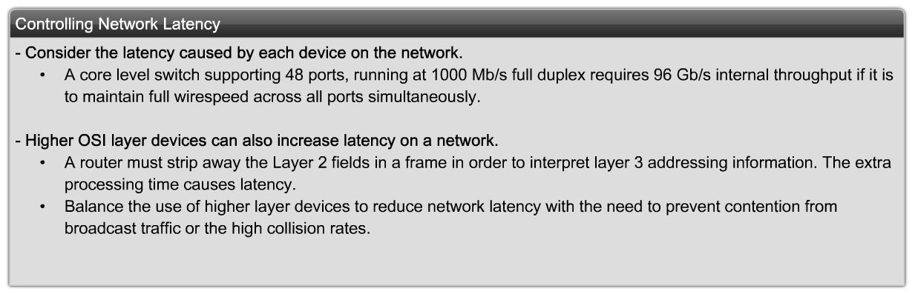
Summarize the operation of Ethernet as defined for 100/1000 Mbps LANs in the IEEE 802.3 standard
Describe the LAN design considerations to reduce network latency

Slide 6
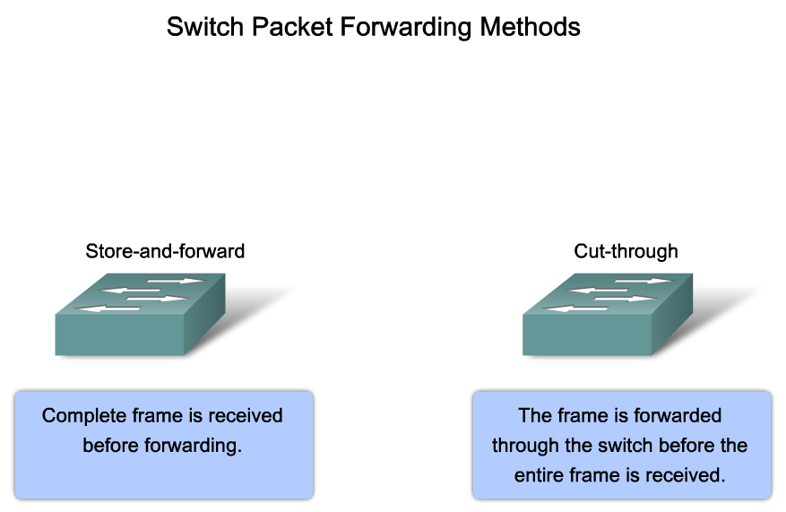
Explain the Functions that Enable a Switch to Forward Ethernet Frames in a LAN
Describe the switch forwarding methods

Slide 7
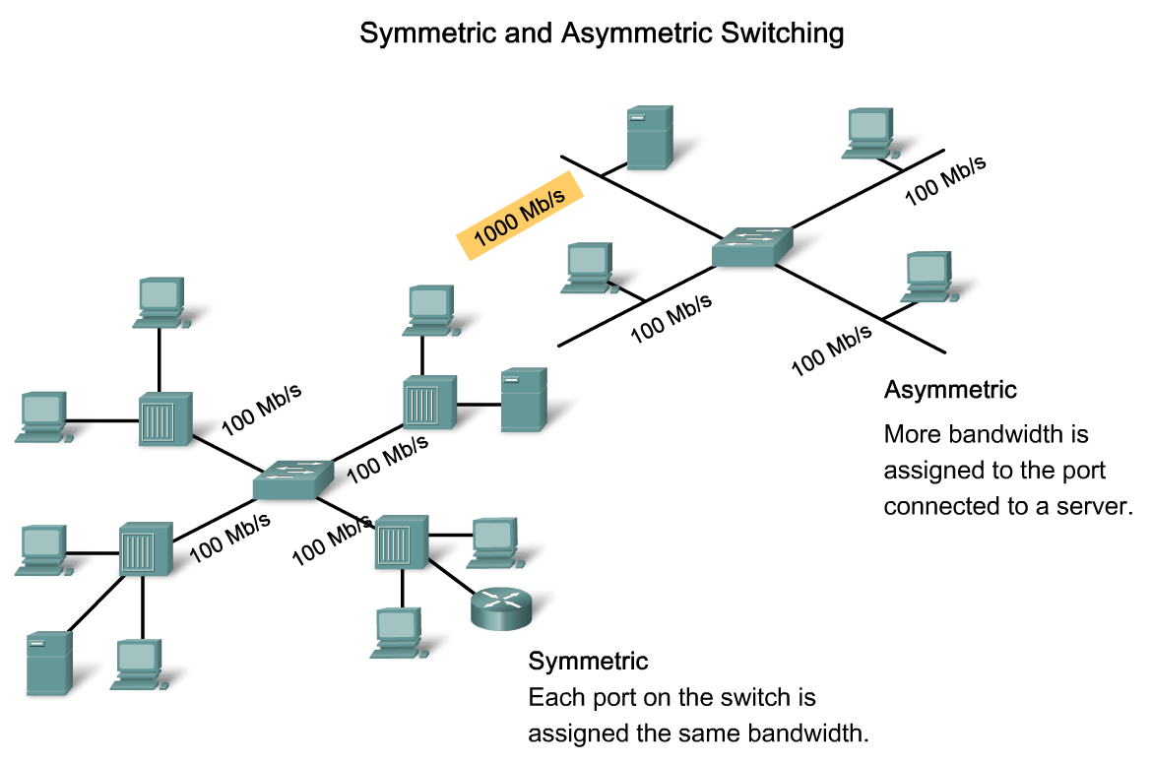
Explain the Functions that Enable a Switch to Forward Ethernet Frames in a LAN
Explain symmetric and asymmetric Switching

Slide 8
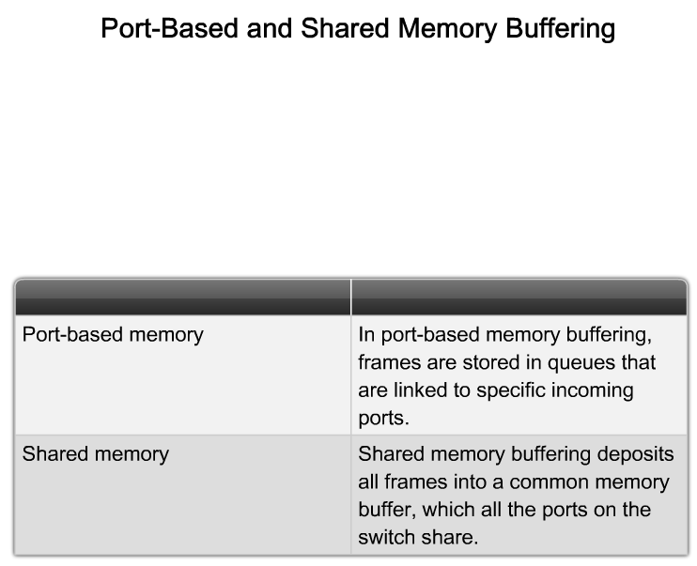
Explain the Functions that Enable a Switch to Forward Ethernet Frames in a LAN
Describe how memory buffering works

Slide 9
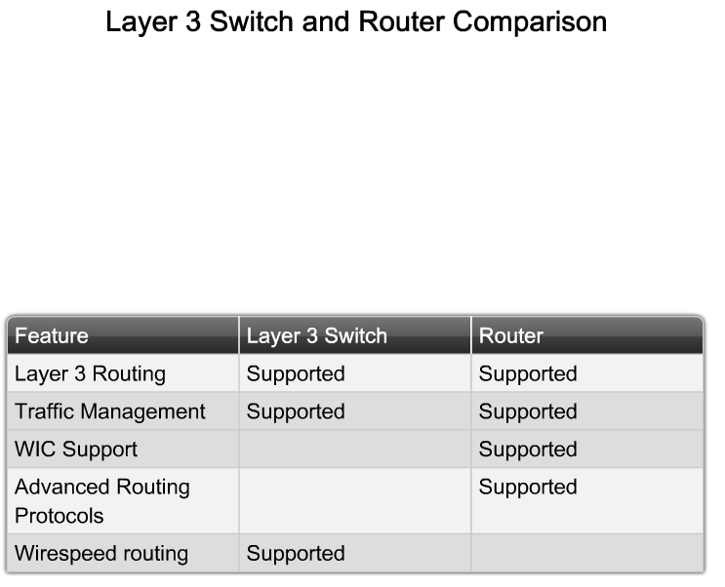
Explain the Functions that Enable a Switch to Forward Ethernet Frames in a LAN
Compare Layer 2 with Layer 3 switching

Slide 10
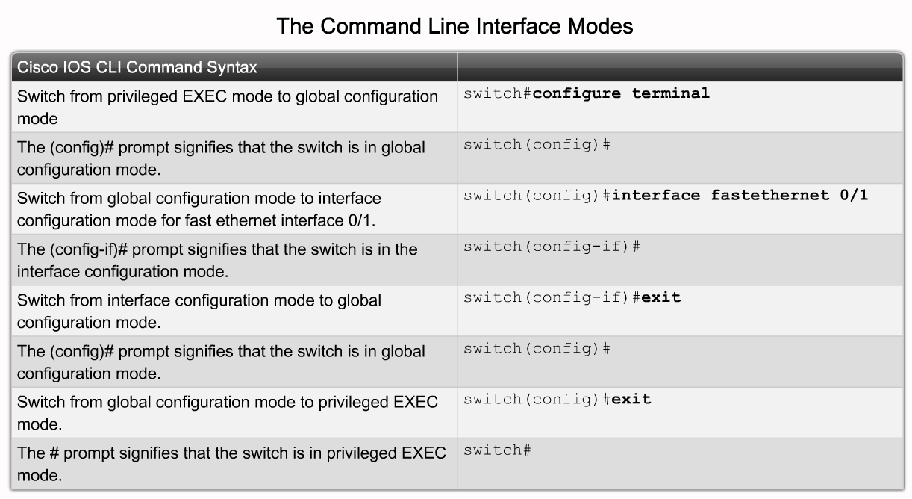
Configure a Switch for Operation in a Network
Describe the Cisco IOS commands used to navigate the command-line

Slide 11
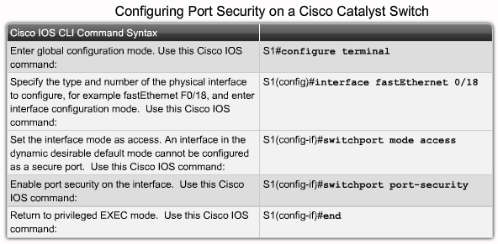
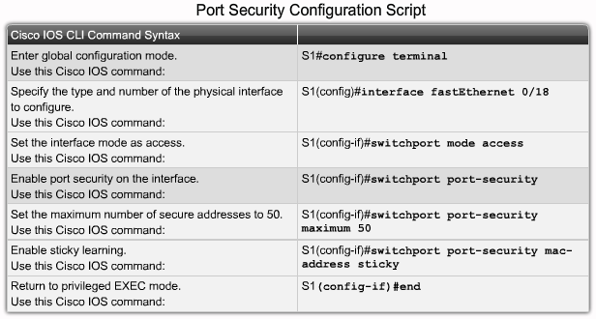
Configure a Switch for Operation in a Network
Describe the Cisco IOS help facilities

Slide 12
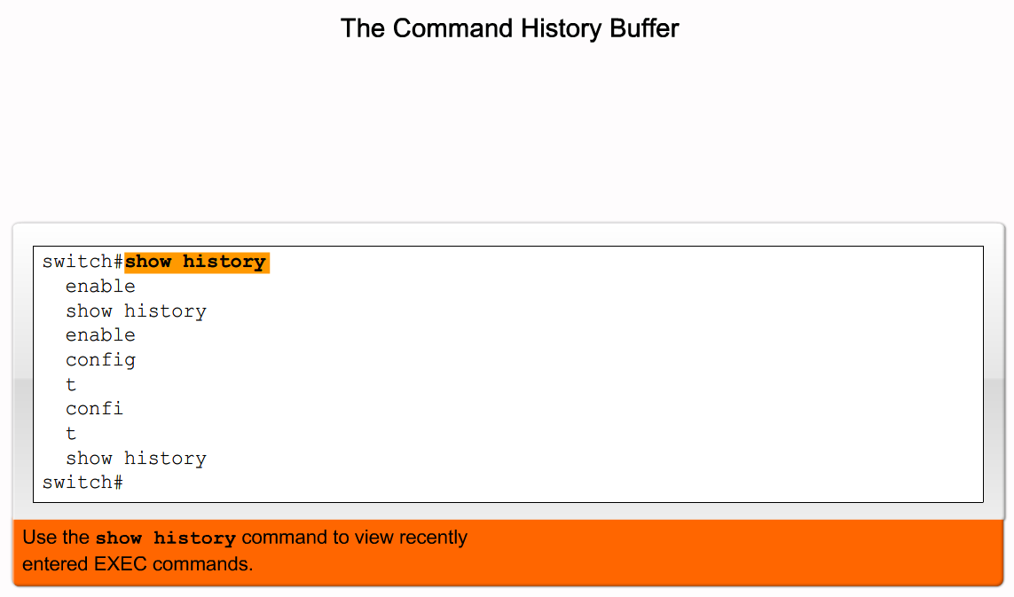
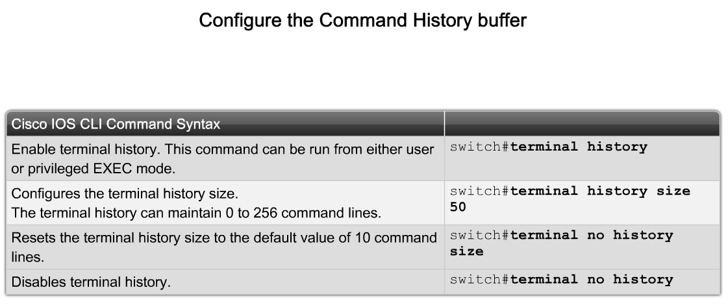
Configure a Switch for Operation in a Network
Describe the Cisco IOS commands used to access the command history

Slide 13
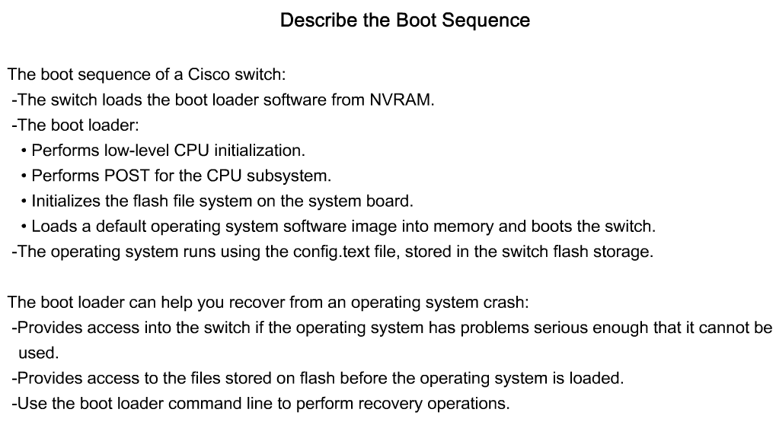
Configure a Switch for Operation in a Network
Describe the boot sequence of a Cisco switch

Slide 14
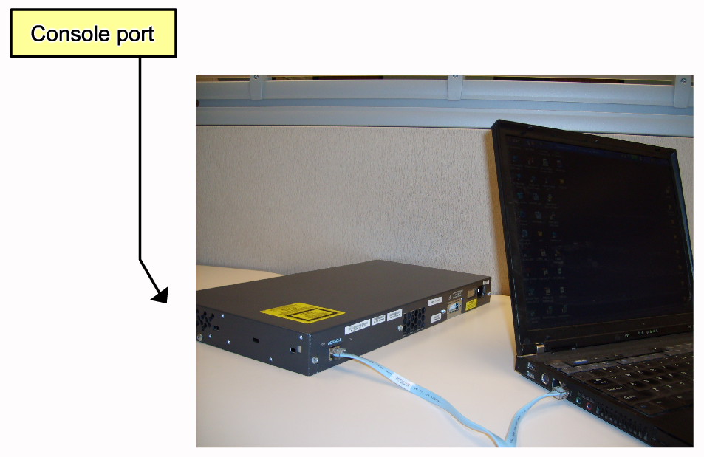
Configure a Switch for Operation in a Network
Describe how to prepare the switch to be configured

Slide 15
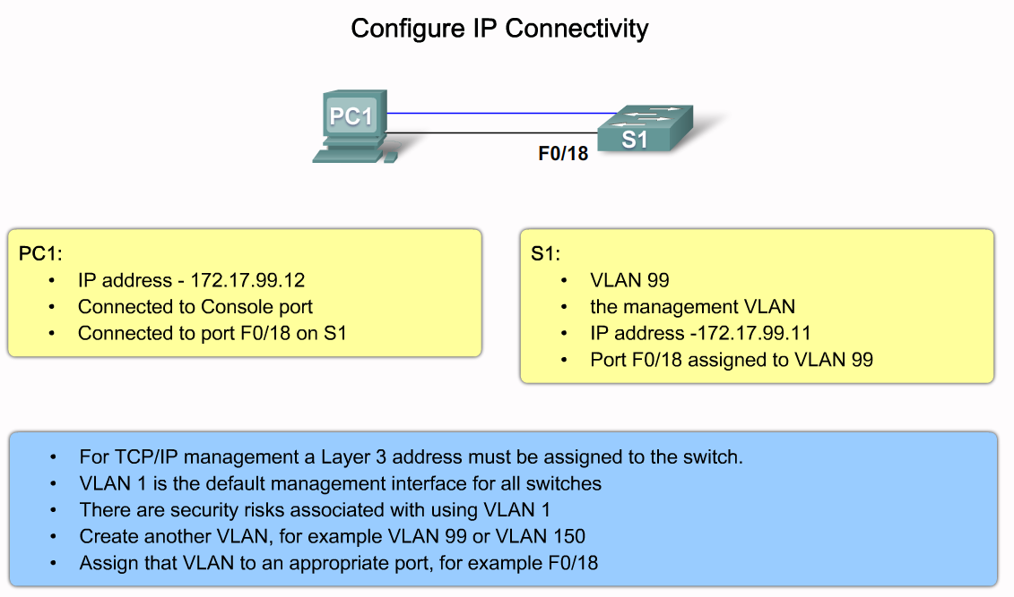
Configure a Switch for Operation in a Network
Describe how to perform a basic switch configuration

Slide 16
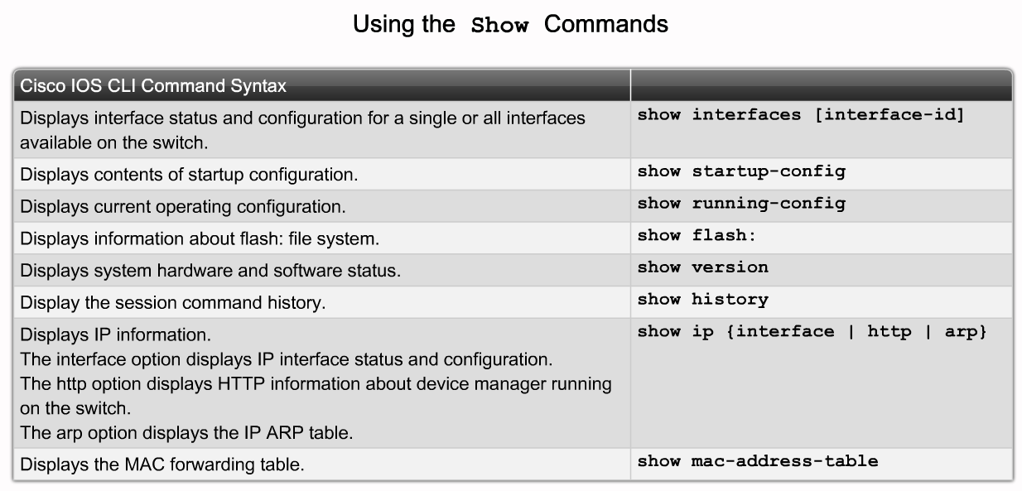
Configure a Switch for Operation in a Network
Describe how to verify the Cisco IOS configuration using the Show command

Slide 17
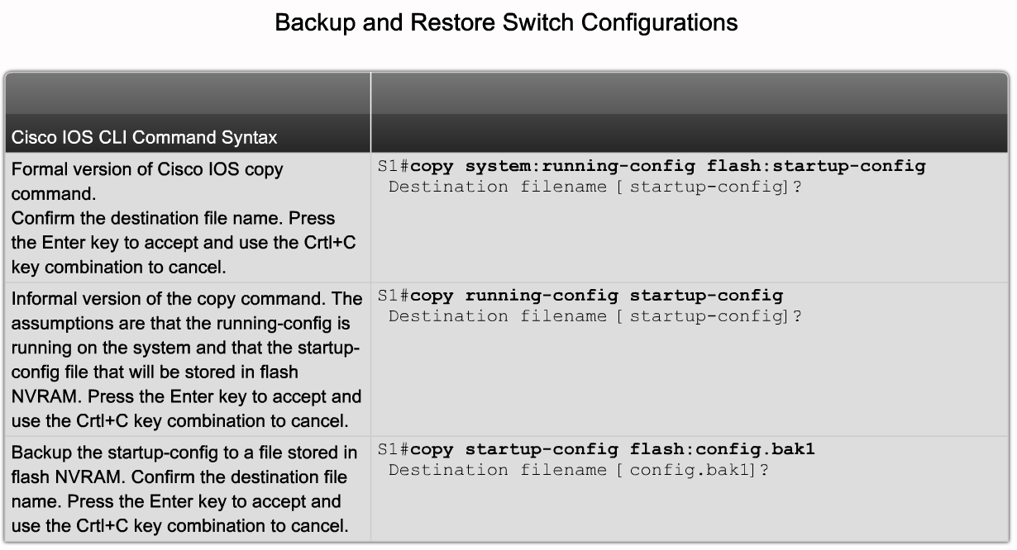
Configure a Switch for Operation in a Network
Describe how to manage the Cisco IOS configuration files

Slide 18
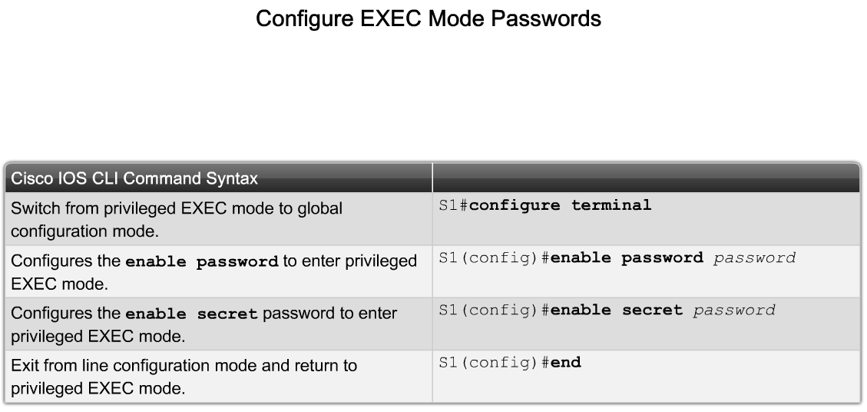
Configure Basic Security on a Switch
Describe the Cisco IOS commands used to configure password options

Slide 19
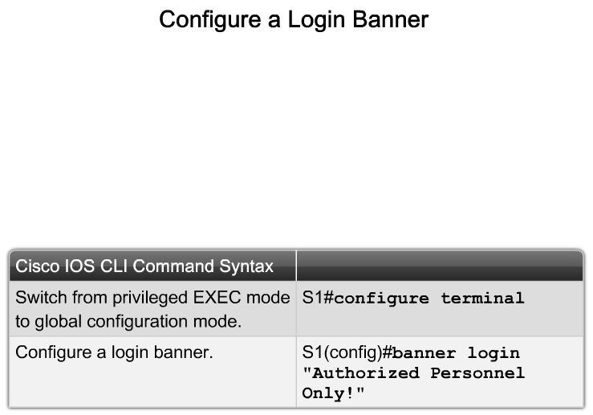
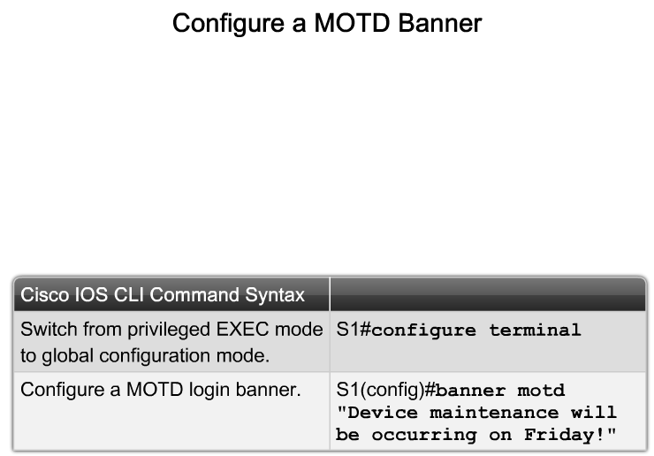
Configure Basic Security on a Switch
Describe the Cisco IOS commands used to configure a login banner

Slide 20
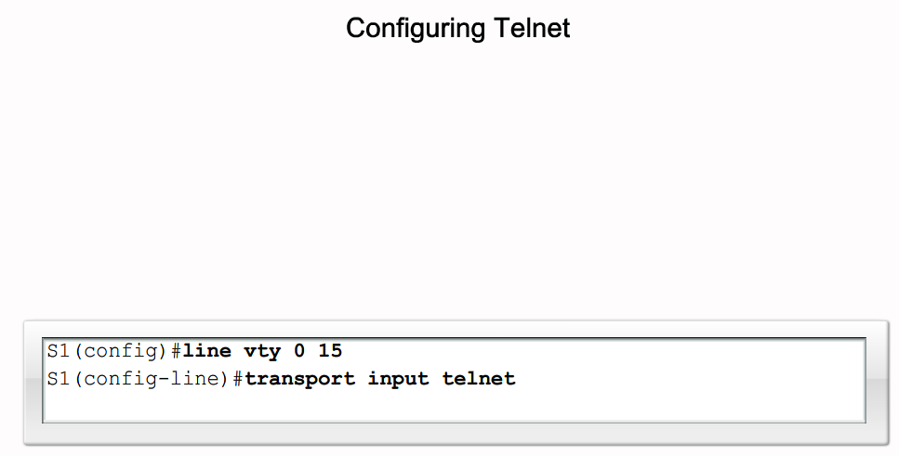
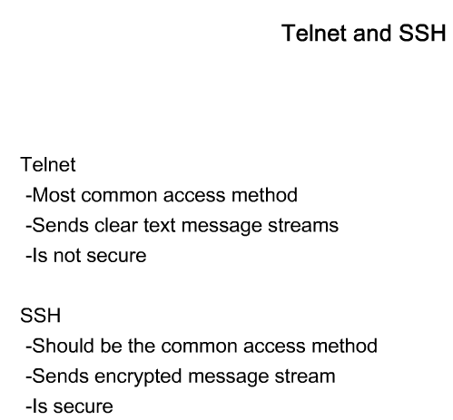
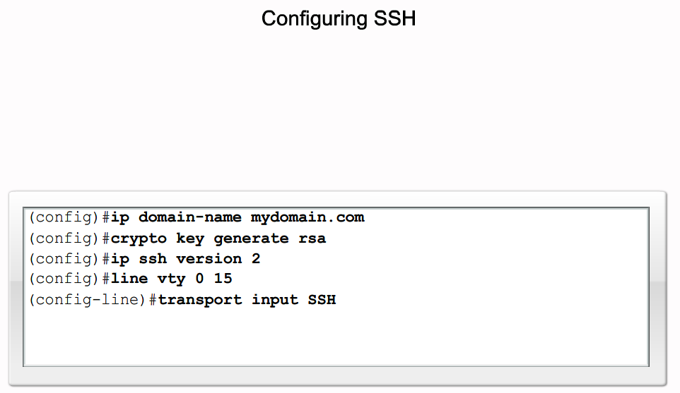
Configure Basic Security on a Switch
Describe the how to configure Telnet and SSH on a switch

Slide 21
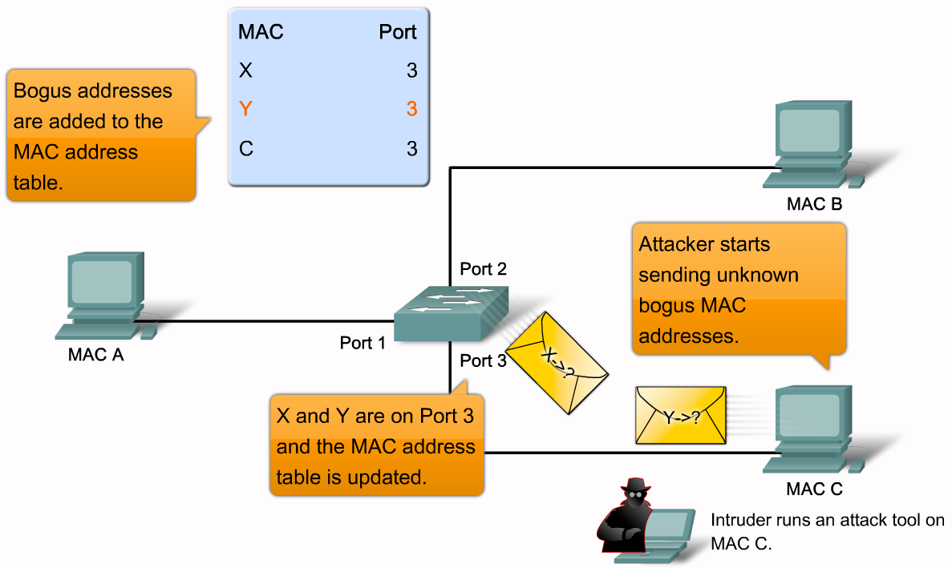
Configure Basic Security on a Switch
Describe the key switch security attacks. The description should include, MAC address flooding, spoofing attacks, CDP attacks, and Telnet attacks

Slide 22
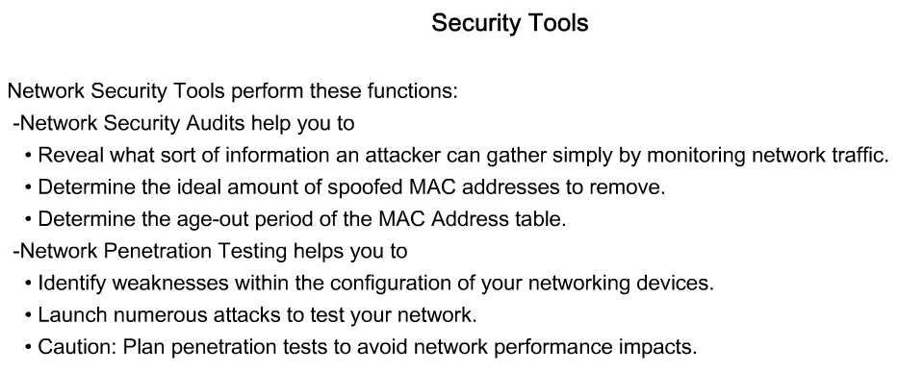
Configure Basic Security on a Switch
Describe how network security tools are used to improve network security

Slide 23
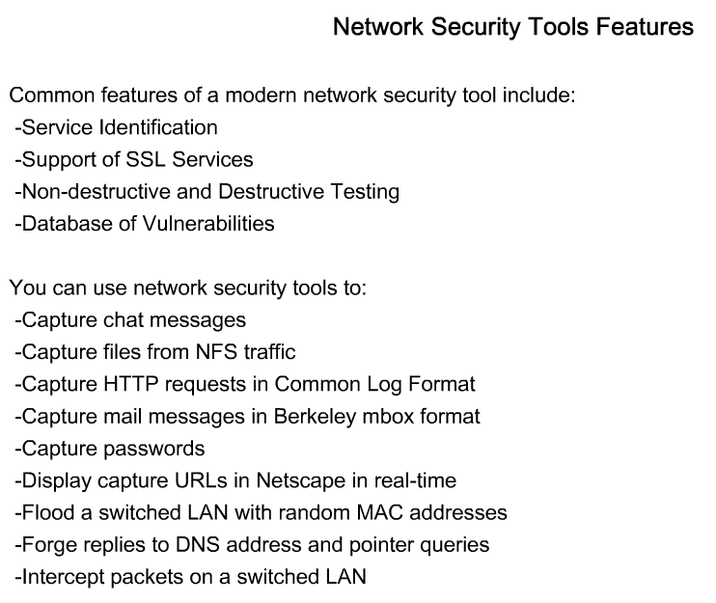
Configure Basic Security on a Switch
Describe why you need to secure ports on a switch

Slide 24
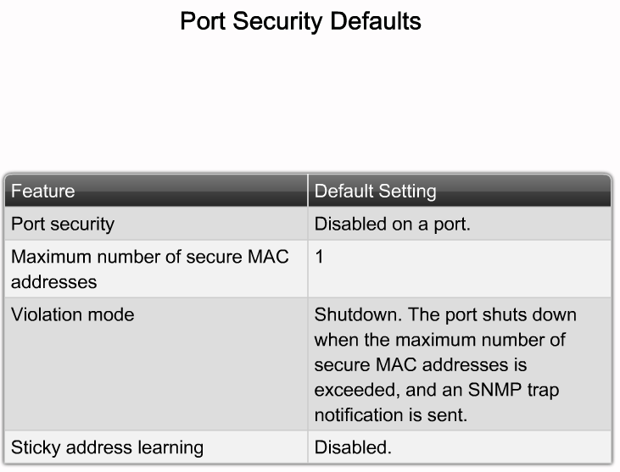
Configure Basic Security on a Switch
Describe the Cisco IOS commands used to disable unused ports

Slide 25
Summary
LAN Design
Process that explains how a LAN is to be implemented
Factors to consider in LAN design include
Collision domains
Broadcast domains
Network latency
LAN segmentation

Slide 26
Summary
Switch forwarding methods
Store & forward – used by Cisco Catalyst switches
Cut through – 2 types
Cut through
Fast forwarding

Slide 27
Summary
Symmetric switching
Switching is conducted between ports that have the same bandwidth
Asymmetric switching
Switching is conducted between ports that have unlike bandwidth

Slide 28
Summary
CISCO IOS CLI includes the following features
Built in help
Command history/options
Switch security
Password protection
Use of SSH for remote access
Port security

